Slide 1
DevOps, or how to build, test, and deploy applications like a boss
Part 2
Eugene Romero
Senior DevOps Engineer
Capgemini Norge

Slide 2
What exactly is the Cloud?

Slide 3

Life before the Cloud

Slide 4



Life before the Cloud
Dedicated Systems team
No simple global reach
Lots of manual labor

Slide 5


Life in a Cloud world

Slide 6
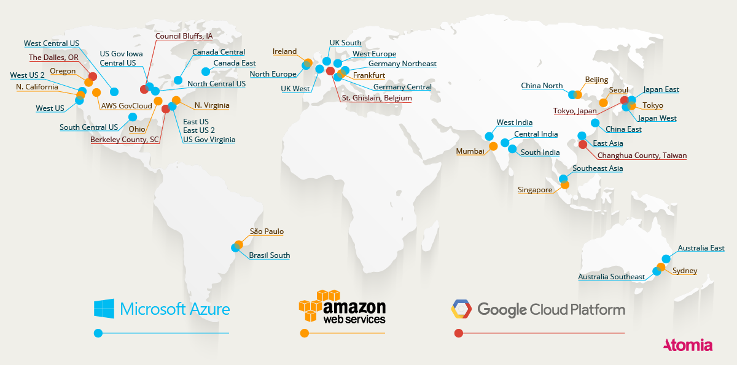
The Cloud is everywhere

Slide 7
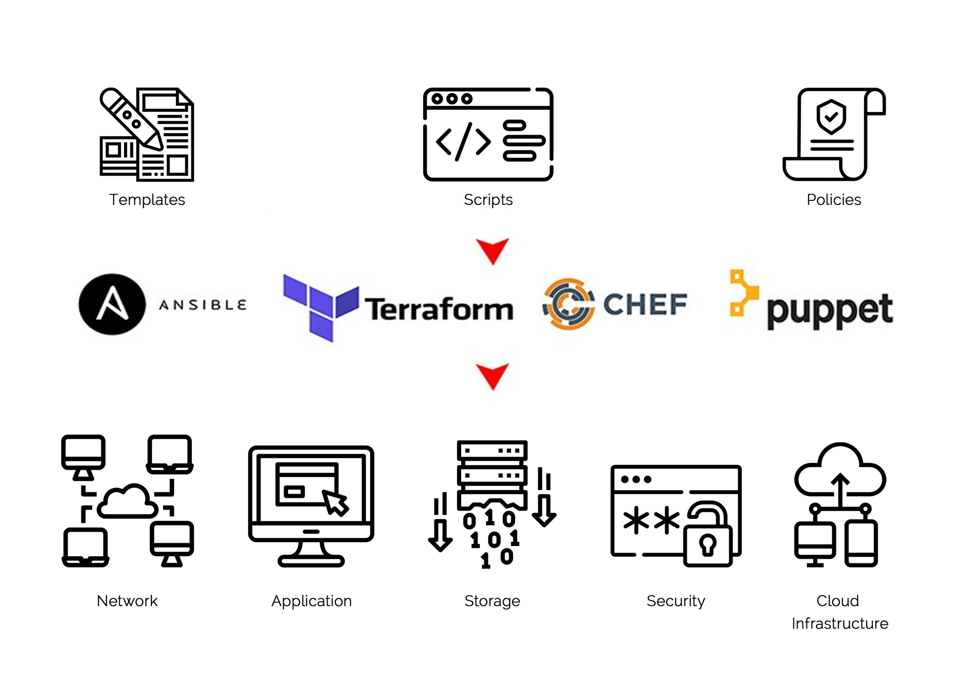
No more manual labor

Slide 8
The Cloud is so much more
Cloud platforms provide many additional services not available in a classic datacenter, as well as unrivaled speed of delivery

Slide 9
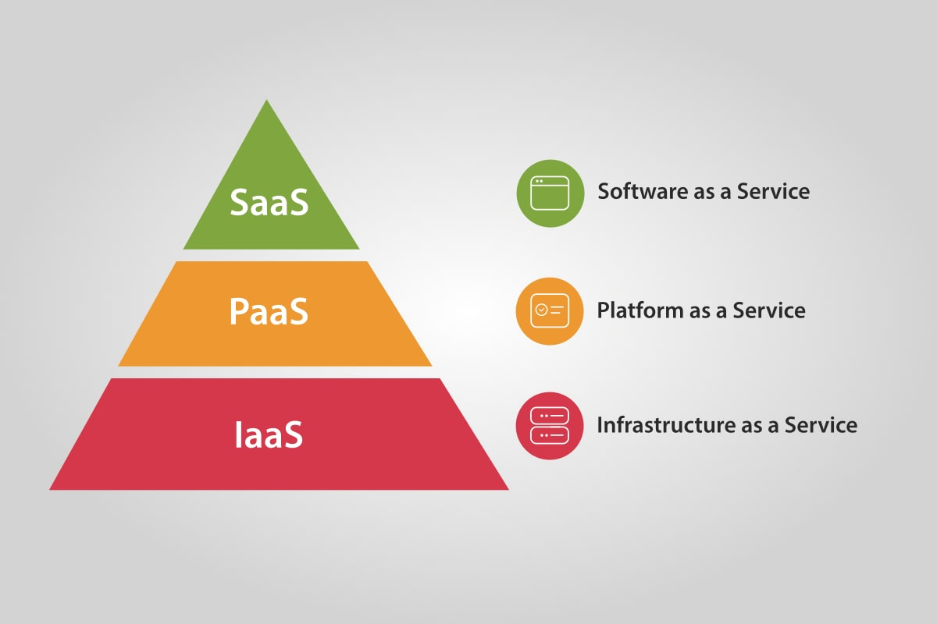
The Cloud is so much more

Slide 10
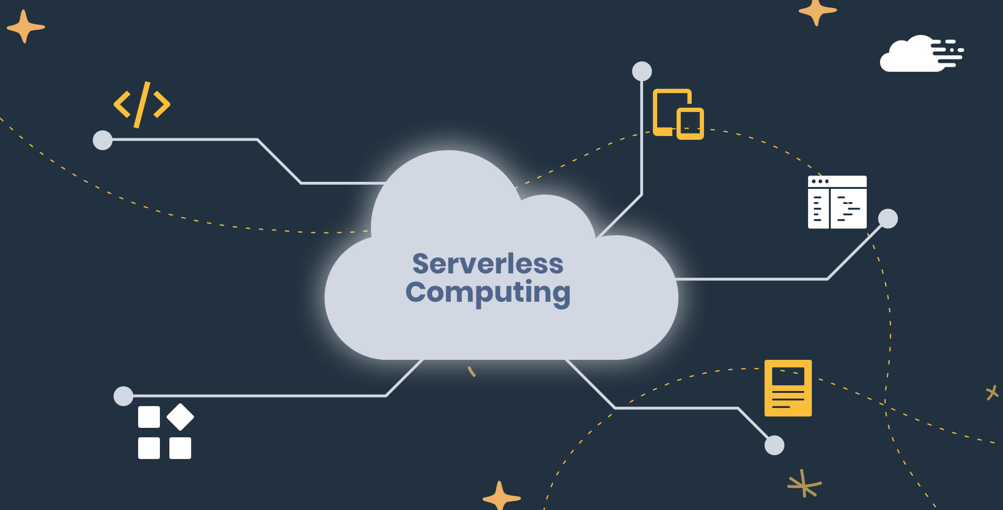
The Cloud is so much more

Slide 11
How can we use Cloud resources?
Three choices:
The bad way
The good way
The less good way

Slide 12
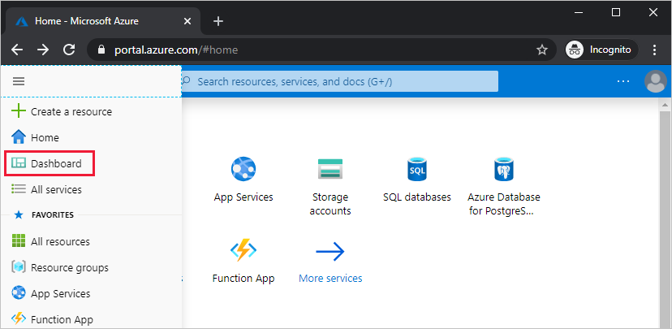
The bad way

Slide 13
Using the web portal
Using the providers’ web portal is fast and good for experimenting, but presents challenges:
Hard to recreate
Hard to grow
Hard to avoid drift

Slide 14
Infrastructure-As-Code (the good way)

Slide 15
Infra-As-Code allows us to...
Keep all infrastructure in the same codebase as our app
Avoid snowflakes (idempotence)
Version our infrastructure
Grow fast and consistently
Easy experimenting

Slide 16
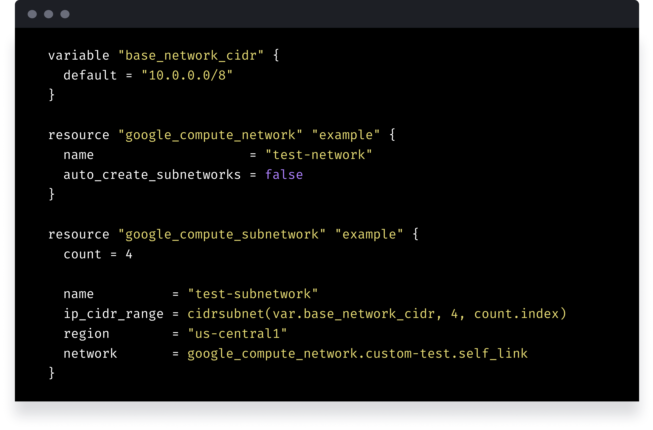
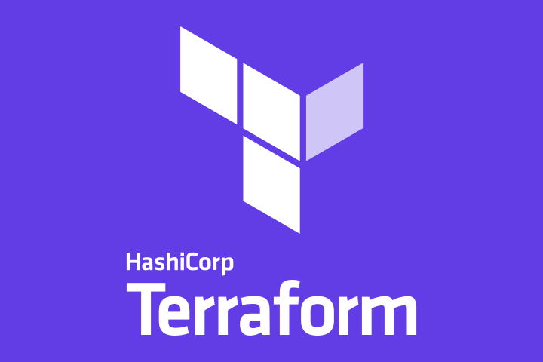
What does it look like?
Notes:
This example is Terraform, which is currently the standard for Cloud Infra As Code

Slide 17
The less good (and less common) way

Slide 18
The “no hands” approach
Some Cloud resources can be deployed by using pre-existing solutions from CI/CD providers, such as GitHub Actions.
This is useful for simple projects with few moving parts.

Slide 19
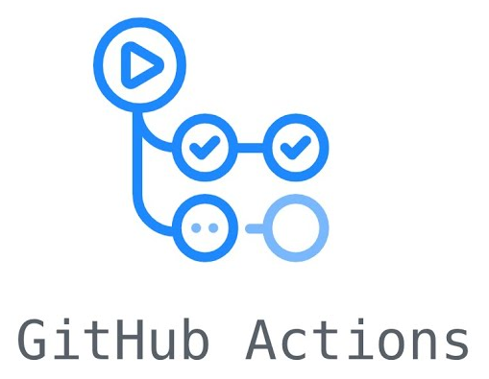
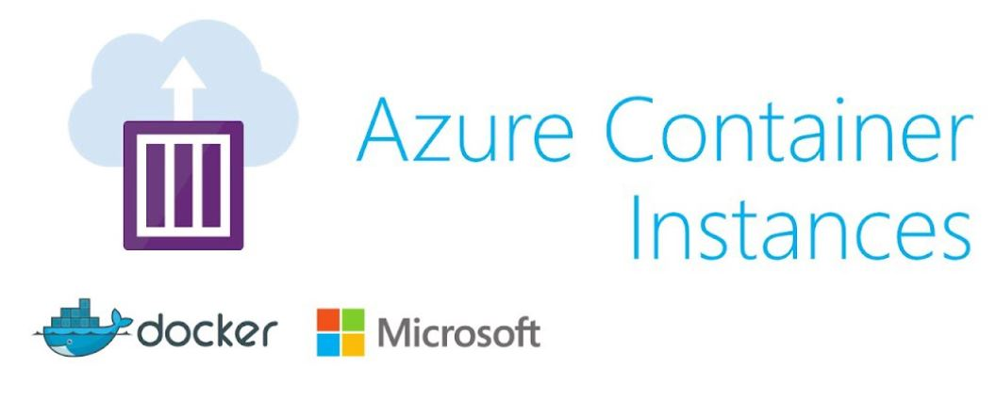
“No hands” approach example

Slide 20
Instructions
Create Azure resource group
Login to Az CLI (az login)
Create Azure service principal (az ad sp create-for-rbac --name "NAME" --role contributor --scopes RESOURCE_GROUP_ID --sdk-auth)
Save credentials as GitHub secret
Update GitHub workflow file
Test pushing updates to application

